Slide 1
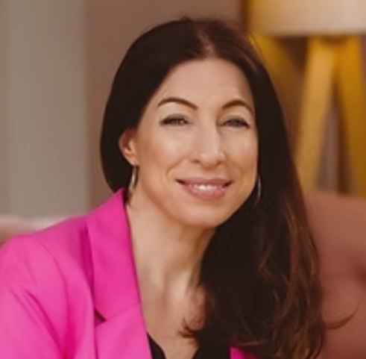


Parents & Grandparents
Sudbury Gainsborough WI
Presents
An evening with
Dr Beth Mosley MBE
Consultant Clinical Psychologist
How do we help our children and grandchildren better navigate a fast-changing world? So that they not only survive, but thrive.
Wednesday, 12 November 2025
7.30pm-9.30pm
Talk and Q&A, book signing - Sudbury Town Hall
Tickets £5.00 (to include refreshments)
Tickets available from Ticketsource website– search Dr Beth Mosely to find the event.
“The task of being a parent is huge, and that is on a good day when life is going well?”

